Slide 1
Steps to Install Jupyter Notebook

Slide 2
The notebook extends the console-based approach to interactive computing in a qualitatively new direction, providing a web-based application suitable for capturing the whole computation process: developing, documenting, and executing code, as well as communicating the results.

Slide 3


Slide 4
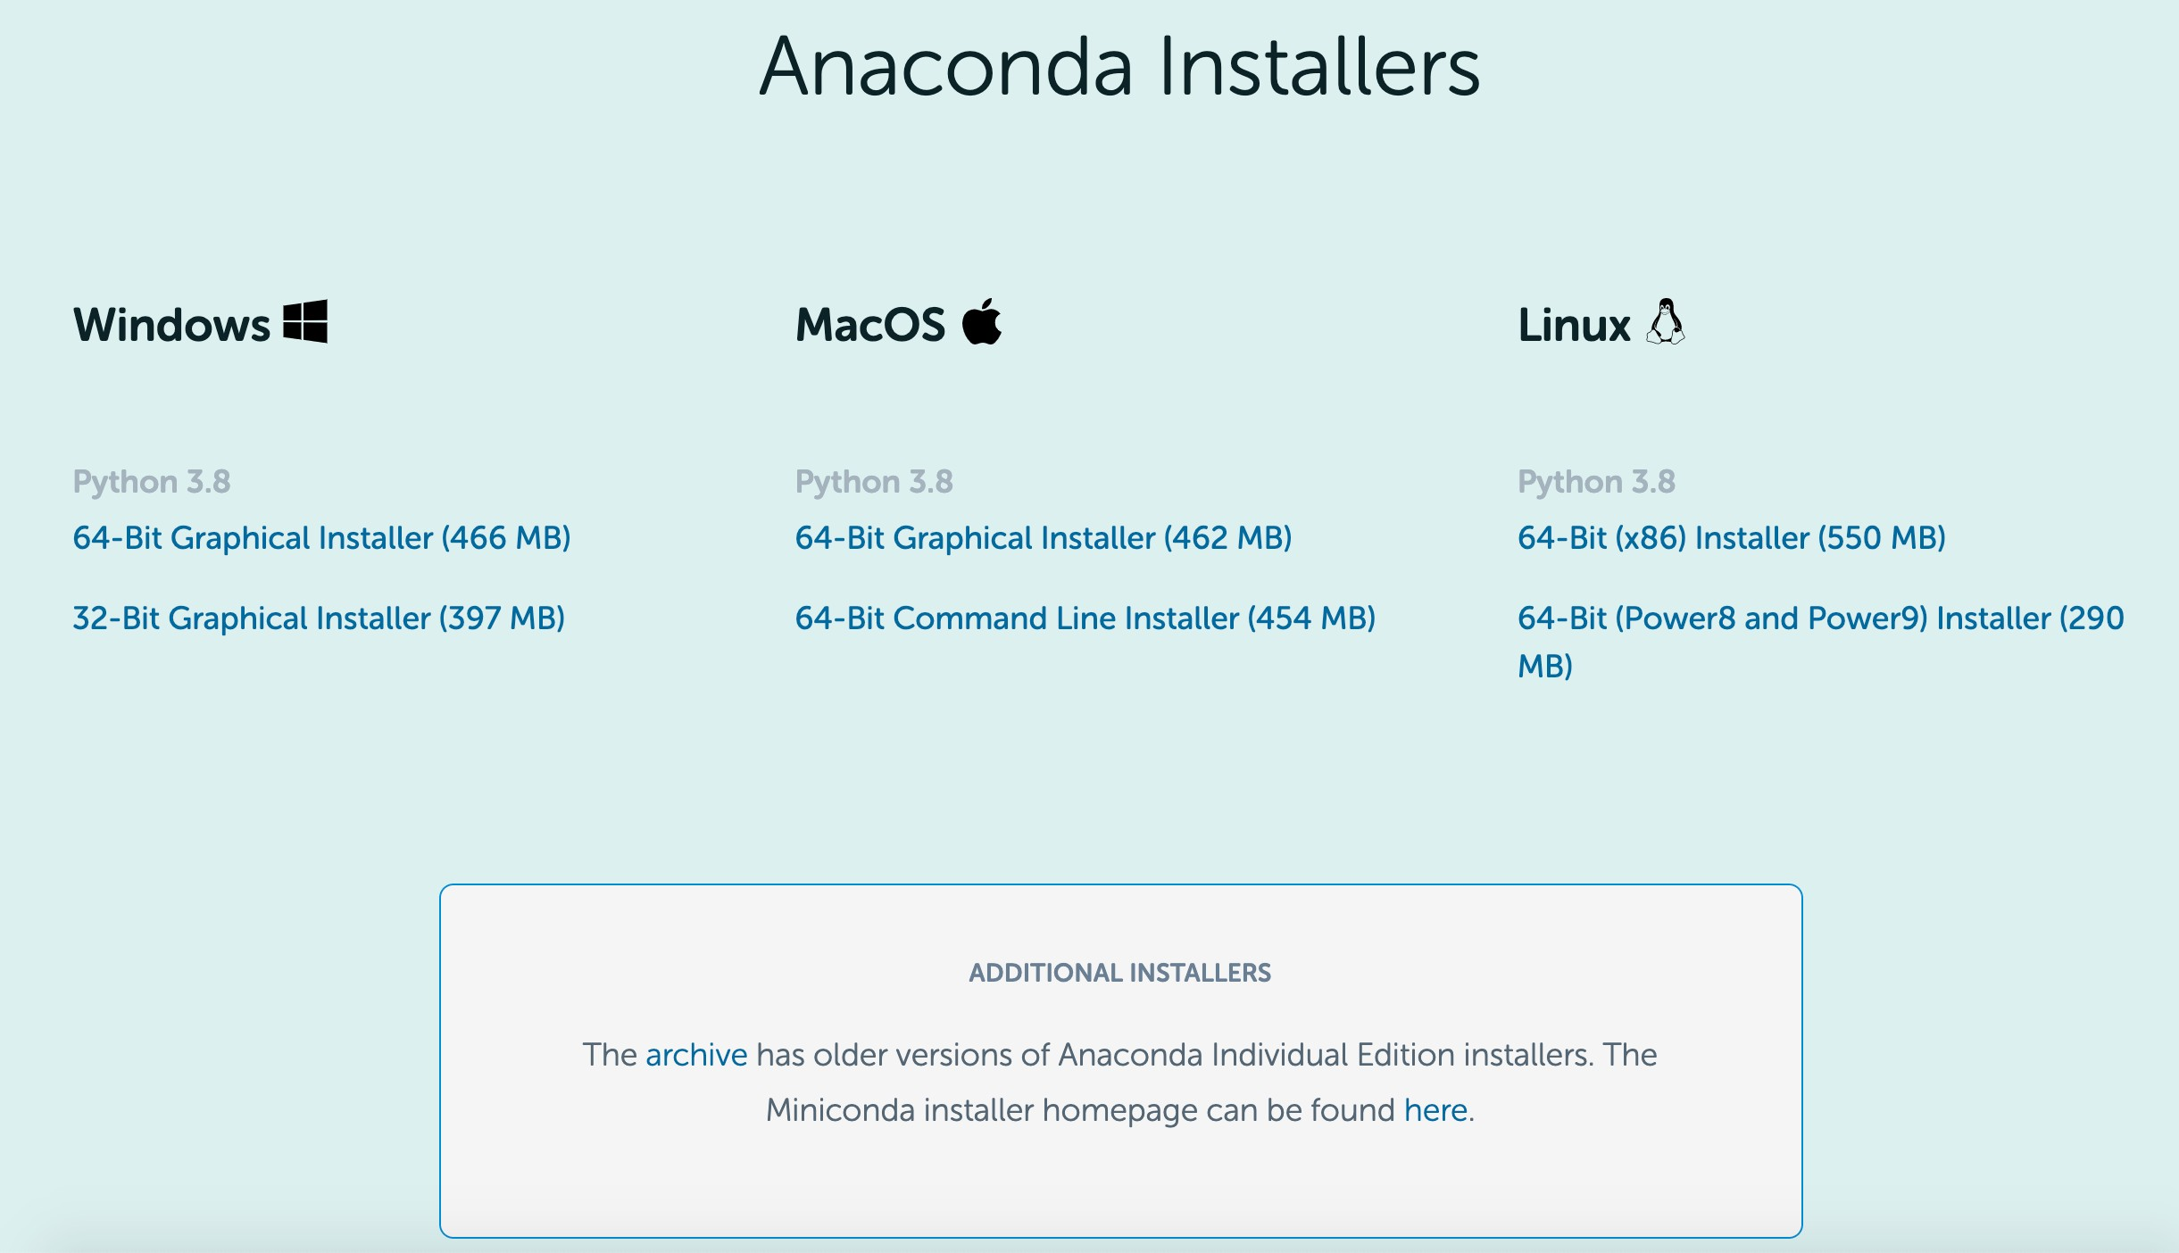
Install Anaconda
1
https://www.anaconda.com/products/individual#windows/
2
Go to the bottom and choose the proper version

Slide 5
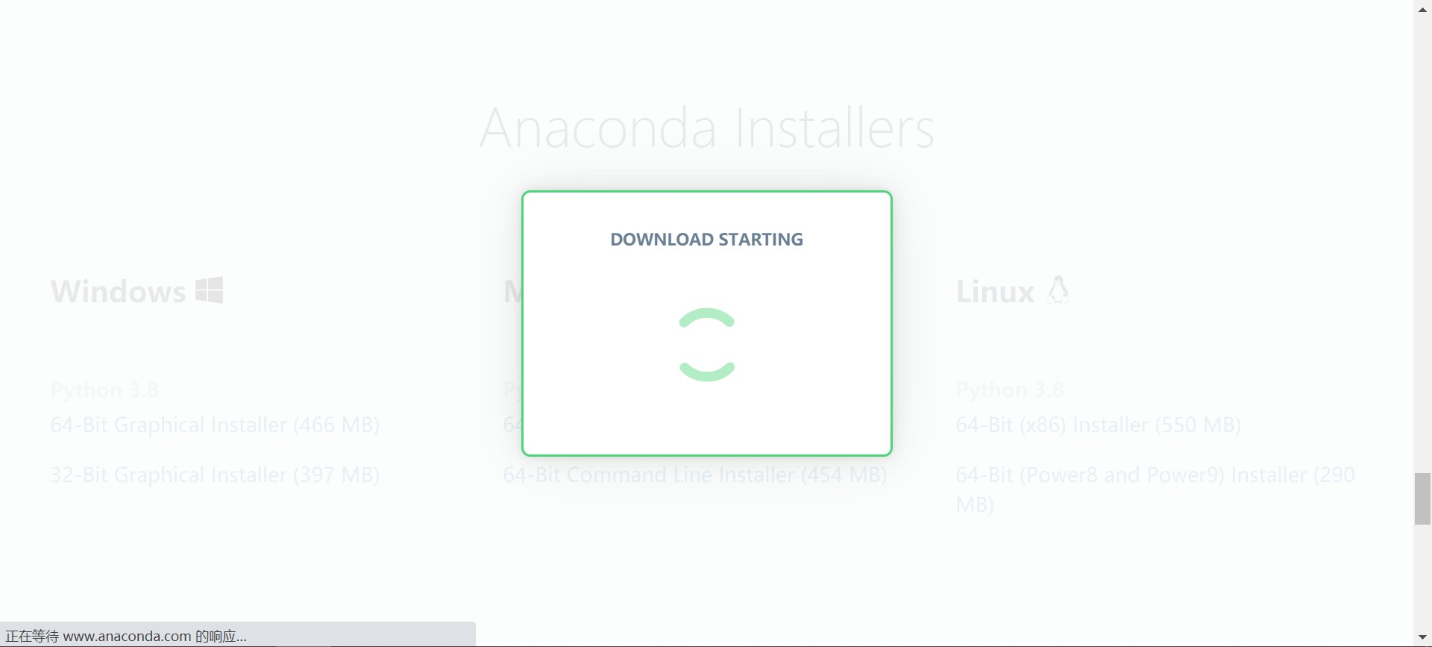

Waiting for downloading…

Slide 6
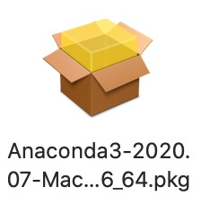
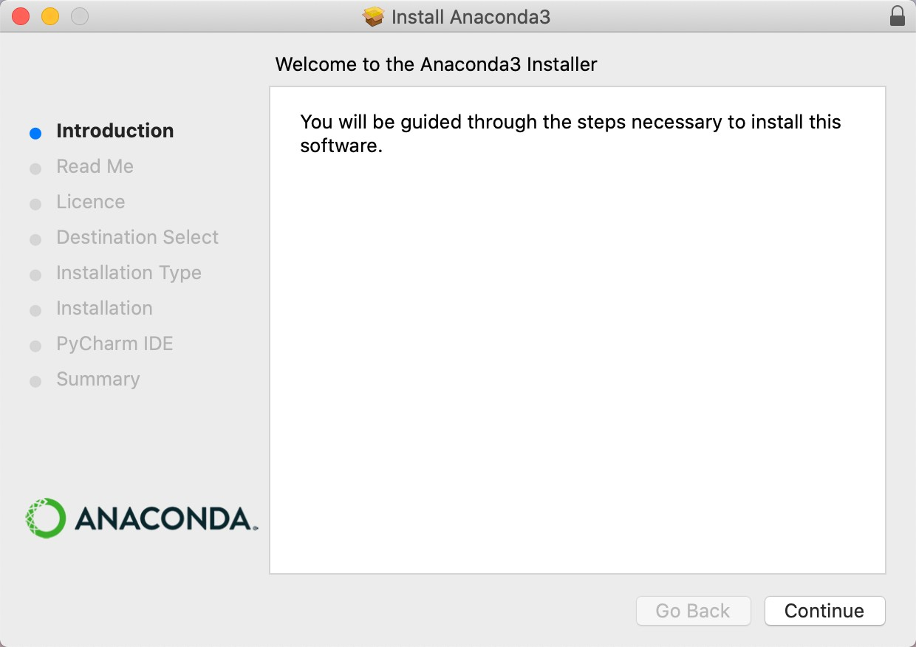
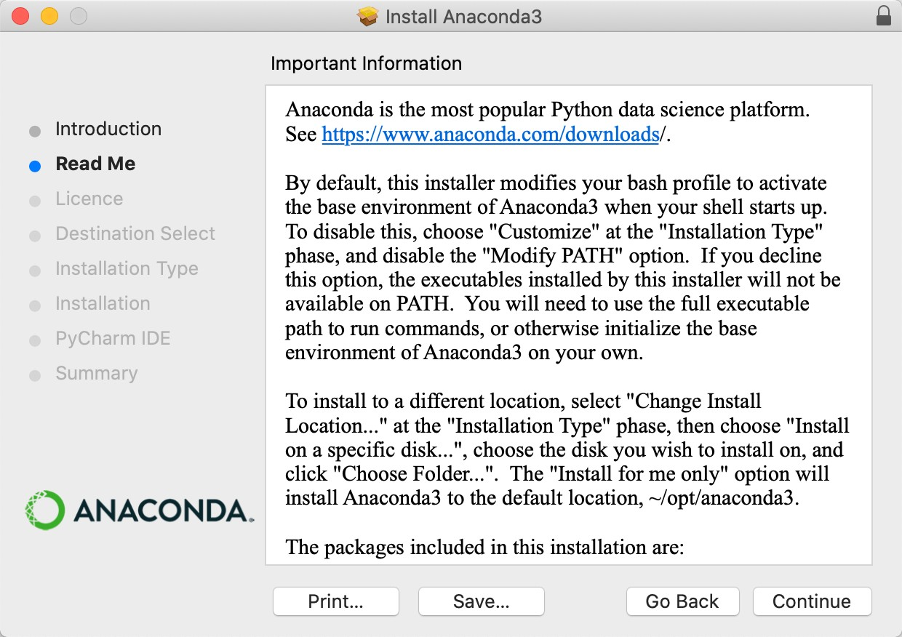
Double-click the package
3
4
5

Slide 7
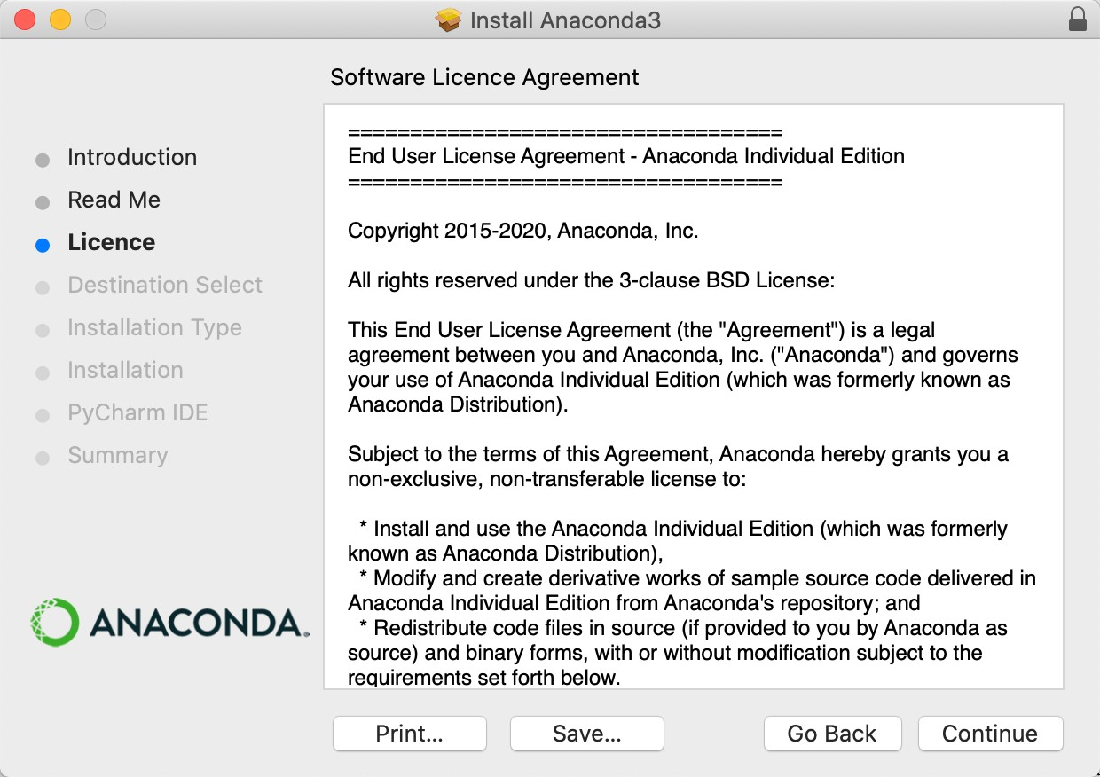
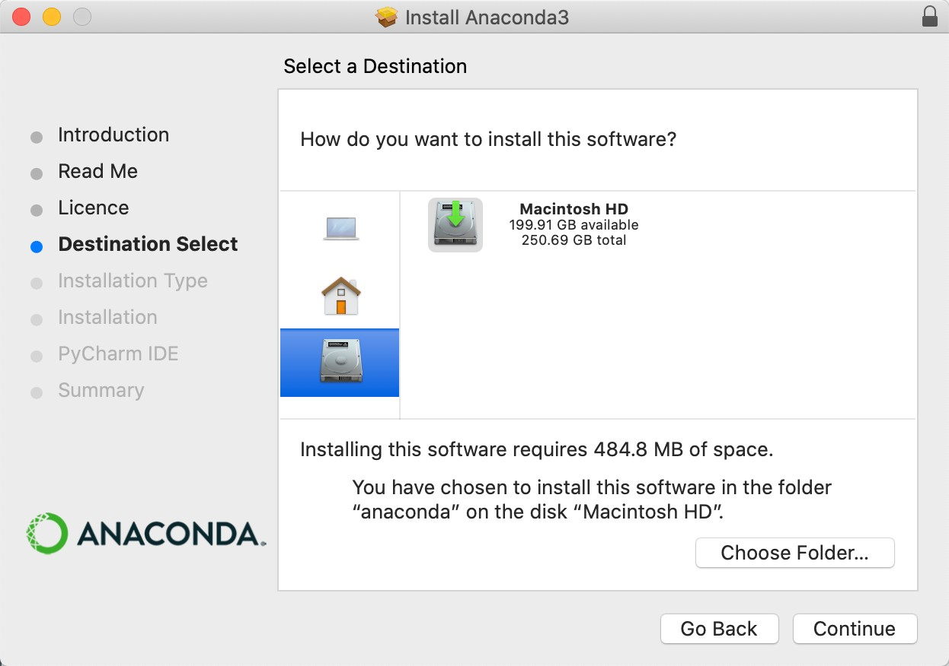
Attention: no spaces in the “Destination Folder”?
6
7

Slide 8
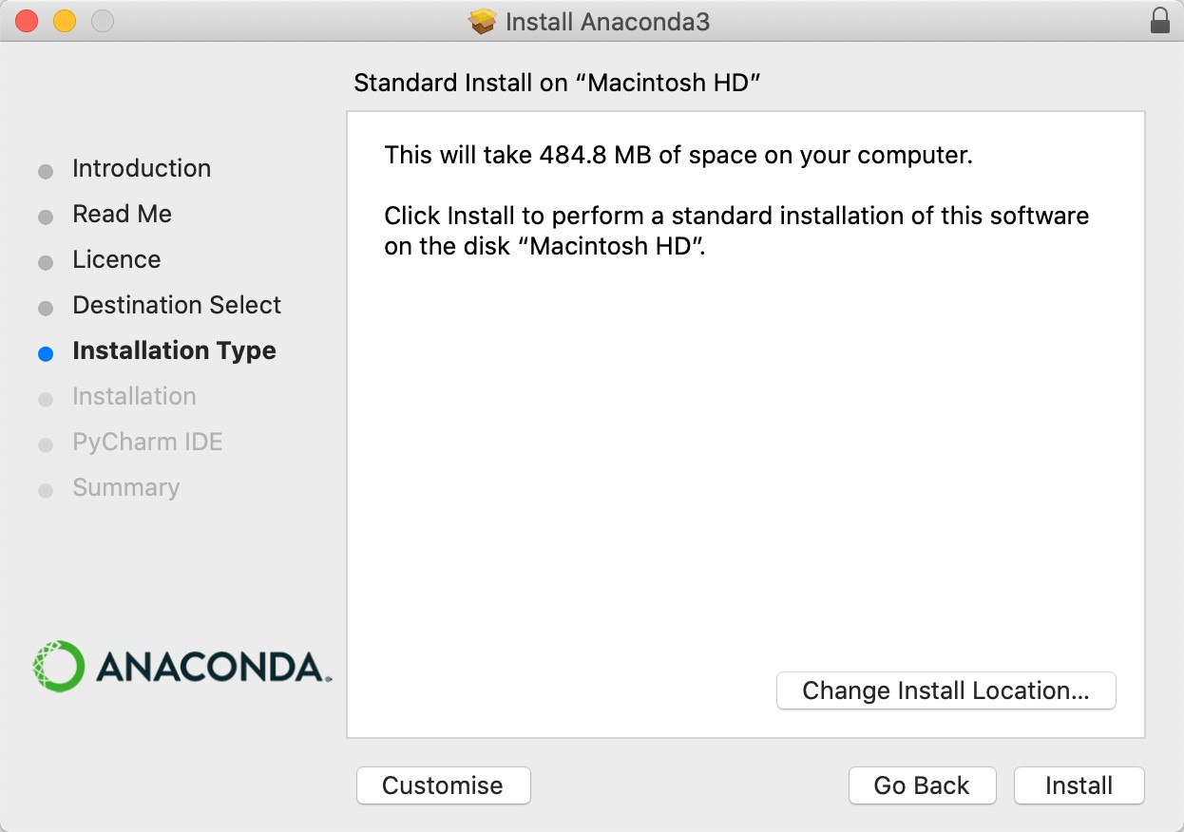
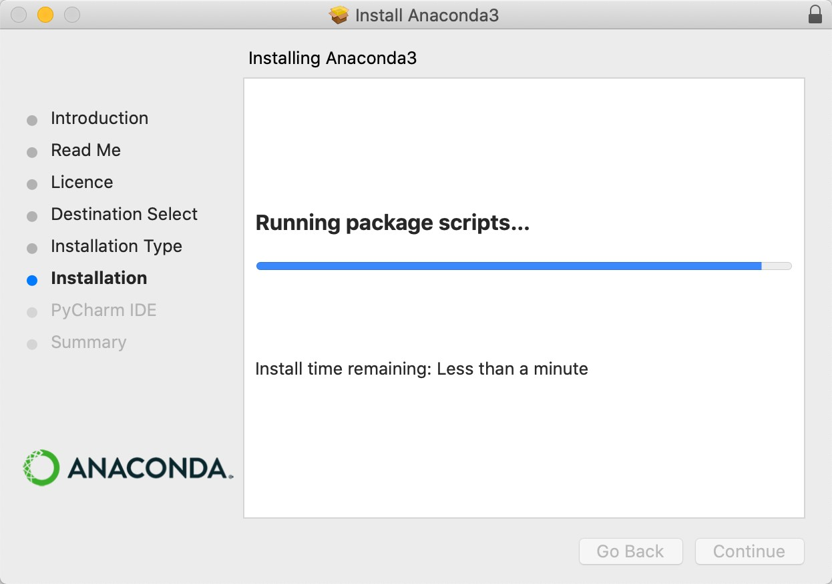
7
8

Slide 9

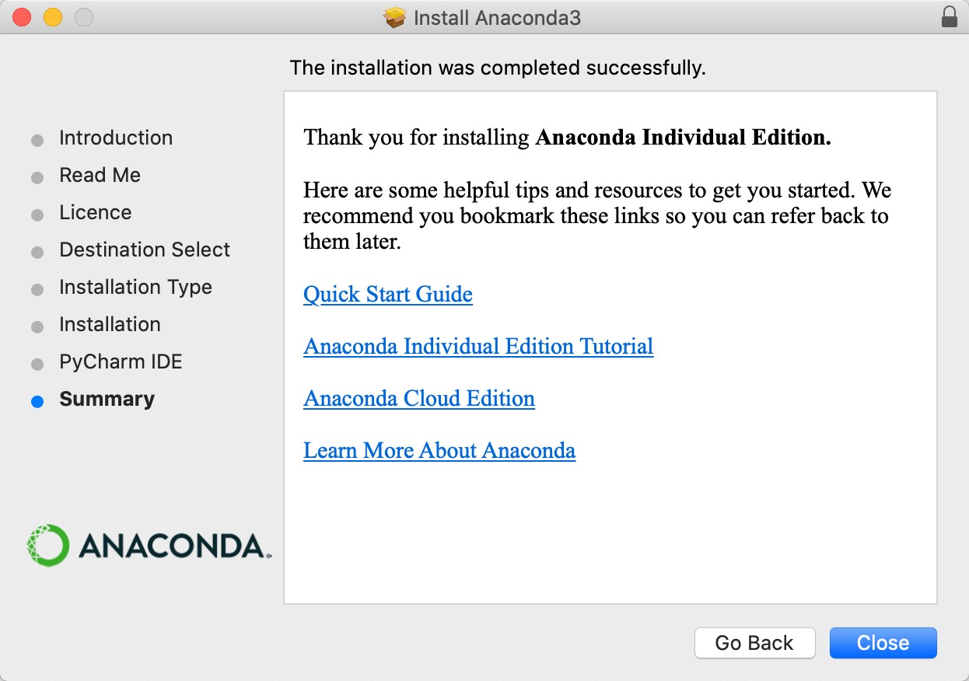
Done!
8

Slide 10
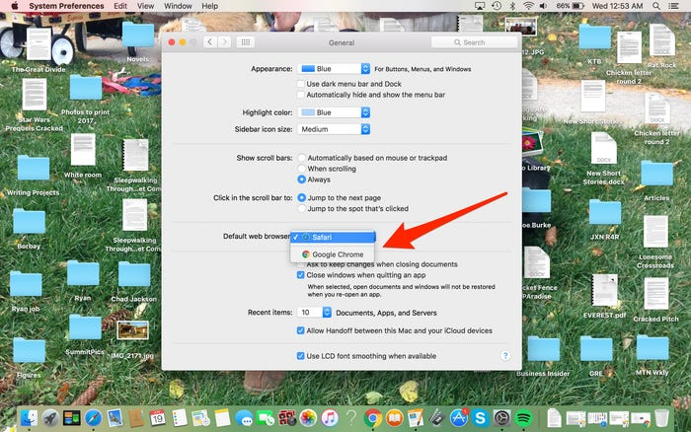
Changing Default Browser(Mac), Optional
Opening Jupyter notebook in
your web browser of choice
https://www.businessinsider.com/how-to-change-default-browser-on-mac
8

Slide 11

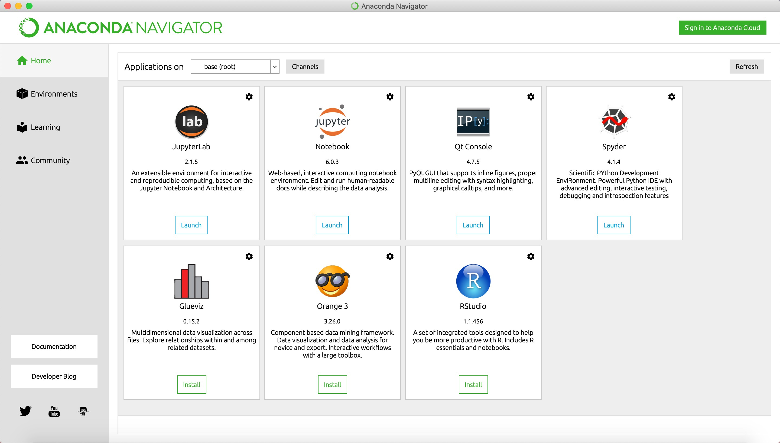
Enjoy!

Slide 12
•••
,-., Home Page - Select or create X
+
(D localhost:8888/tree
* •
••• Apps
M i&i!fffi (5) - wenb... iii Bi!f - BAI Wen -...
G Google
E=l use
1,- Google lfil
E=l cityu
(4t<l*lWl Bffi ...
;:: Jupyter
Quit
Logout
.,
Files Running
Clusters
Select items to perform actions on them.
Upload New
c
o o
Name + Last Modified
File size
0 D Applications
0 D Desktop
0 D Documents
0 D Downloads
0 D Movies
0 D Music
0 D Pictures
0 D Public
2 days ago
20 minutes ago
27 minutes ago
2 days ago
2 days ago
2 days ago
2 days ago
2 days ago

Slide 13


Slide 14
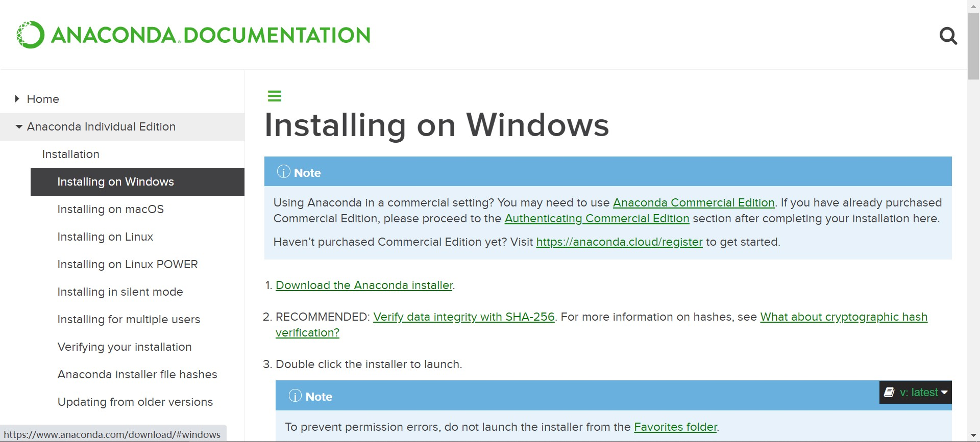
Install Anaconda
1
https://www.anaconda.com/products/individual#windows/

Slide 15
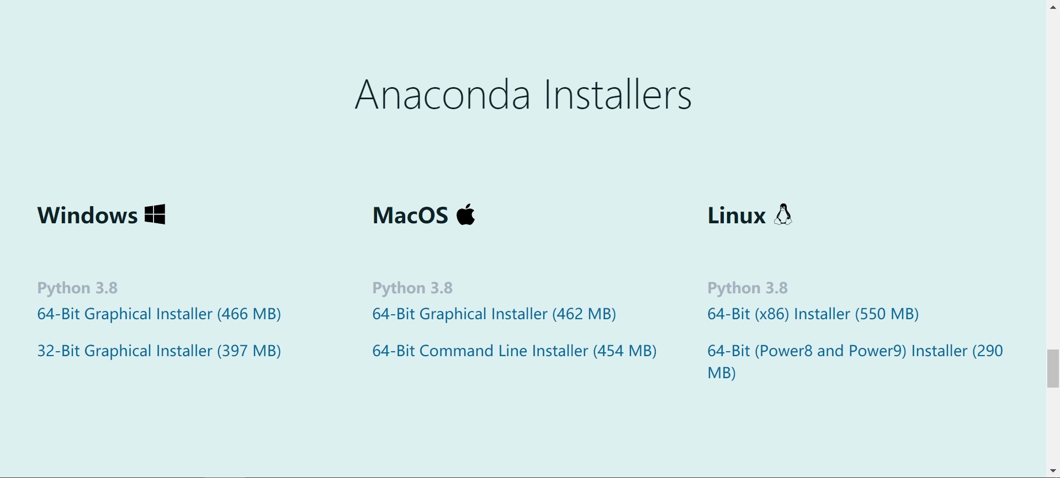
Go to the bottom and choose the proper version
2

Slide 16
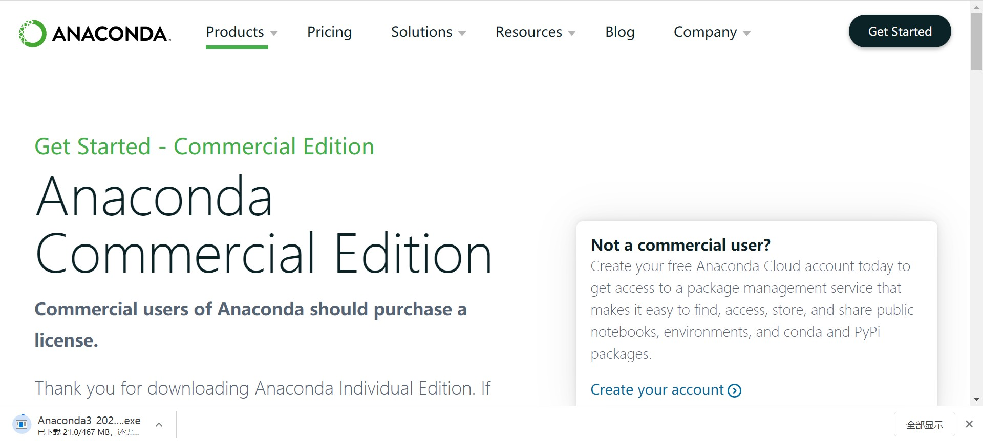
Waiting for downloading…

Slide 17
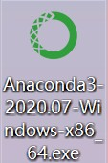
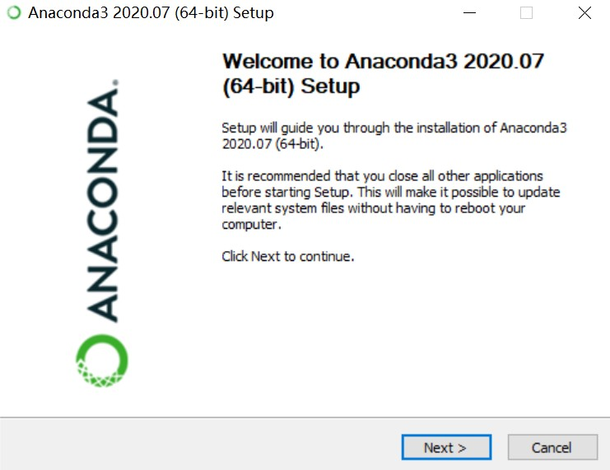
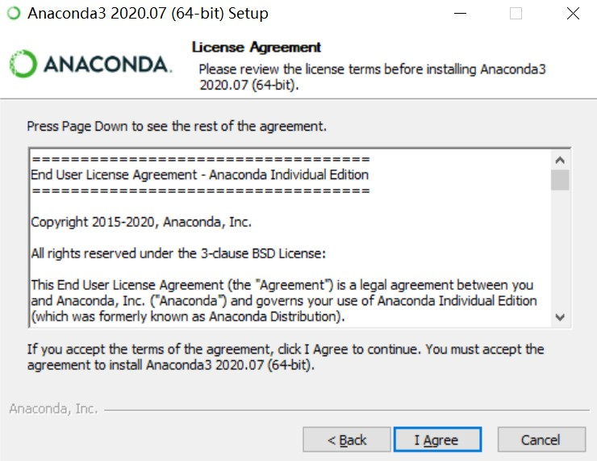
Double-click the package
3
4
5

Slide 18
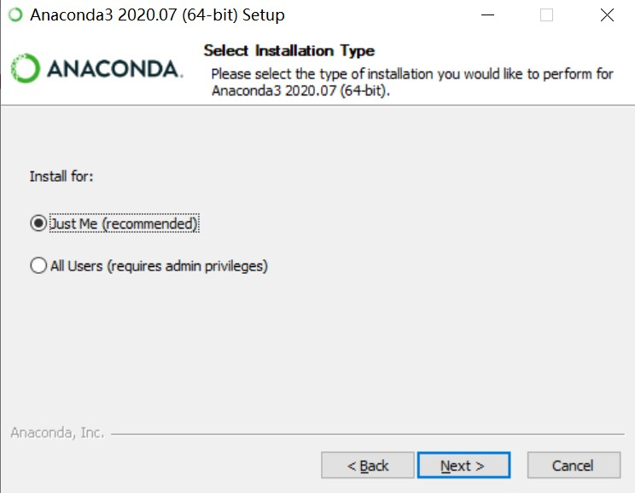
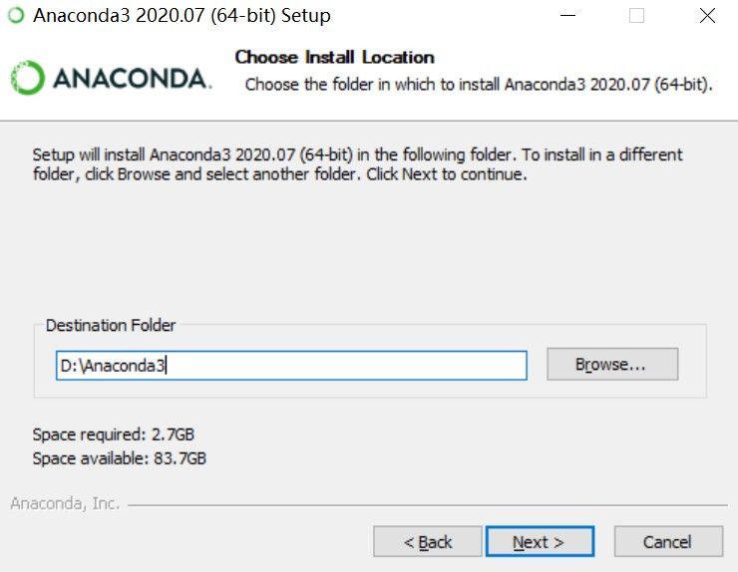
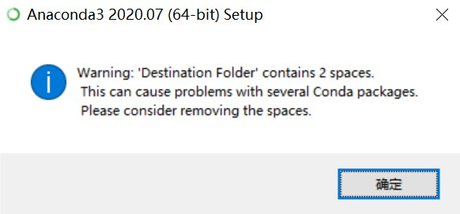
Attention: no spaces in the “Destination Folder”?
6
7
8
9

Slide 19
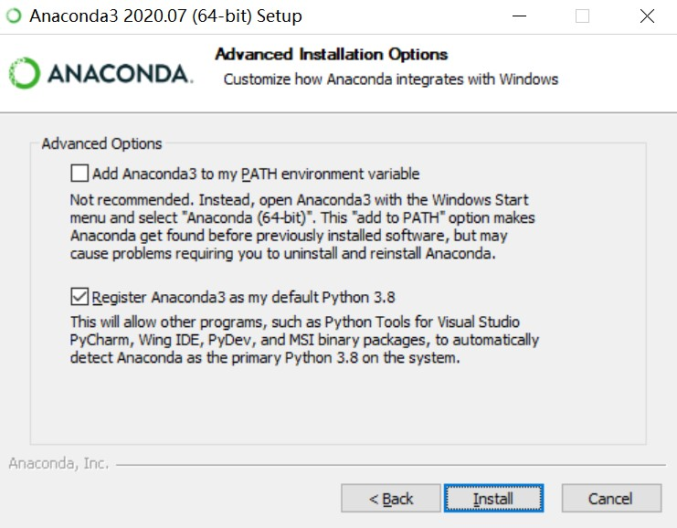
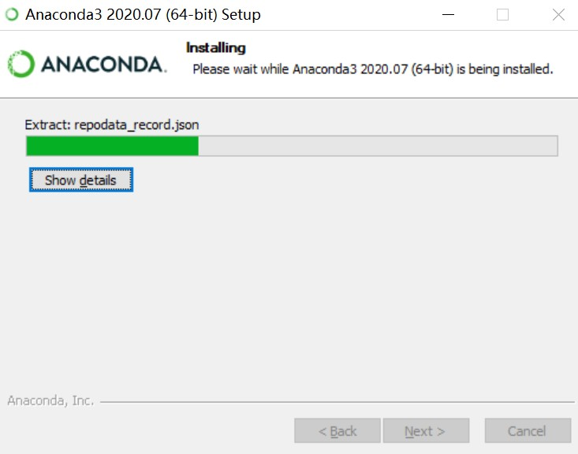
Better to choose the second one : )
10
11

Slide 20
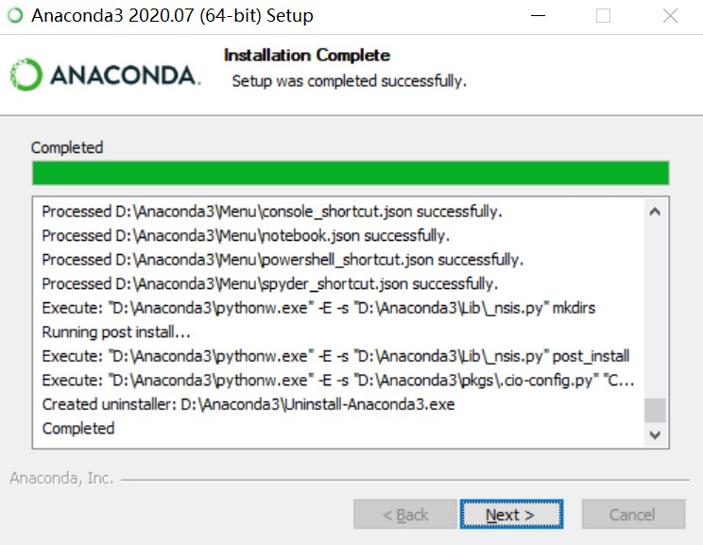
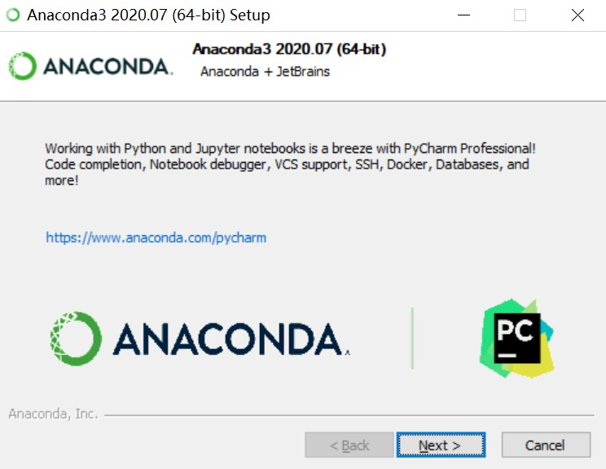
Next…
12
13

Slide 21
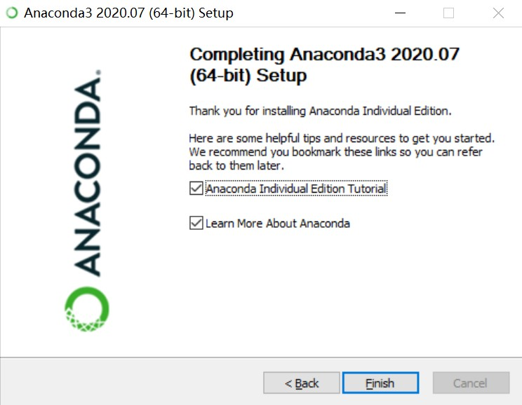
Done!
14
These two options are not important. (optimal)

Slide 22
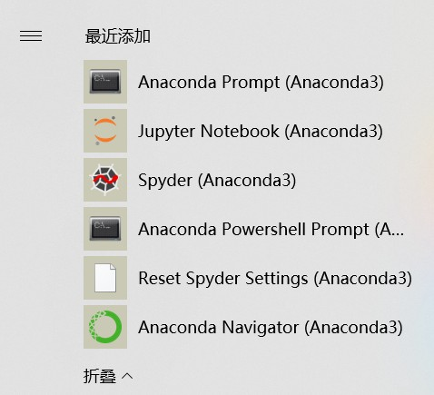
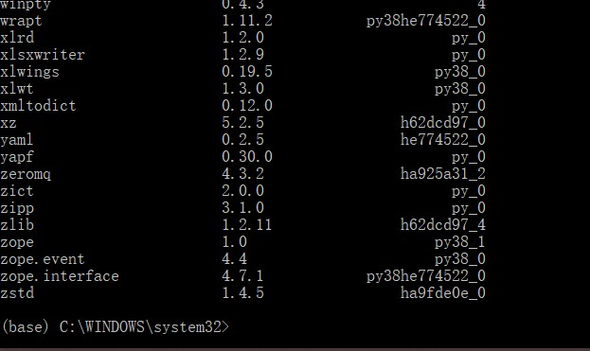
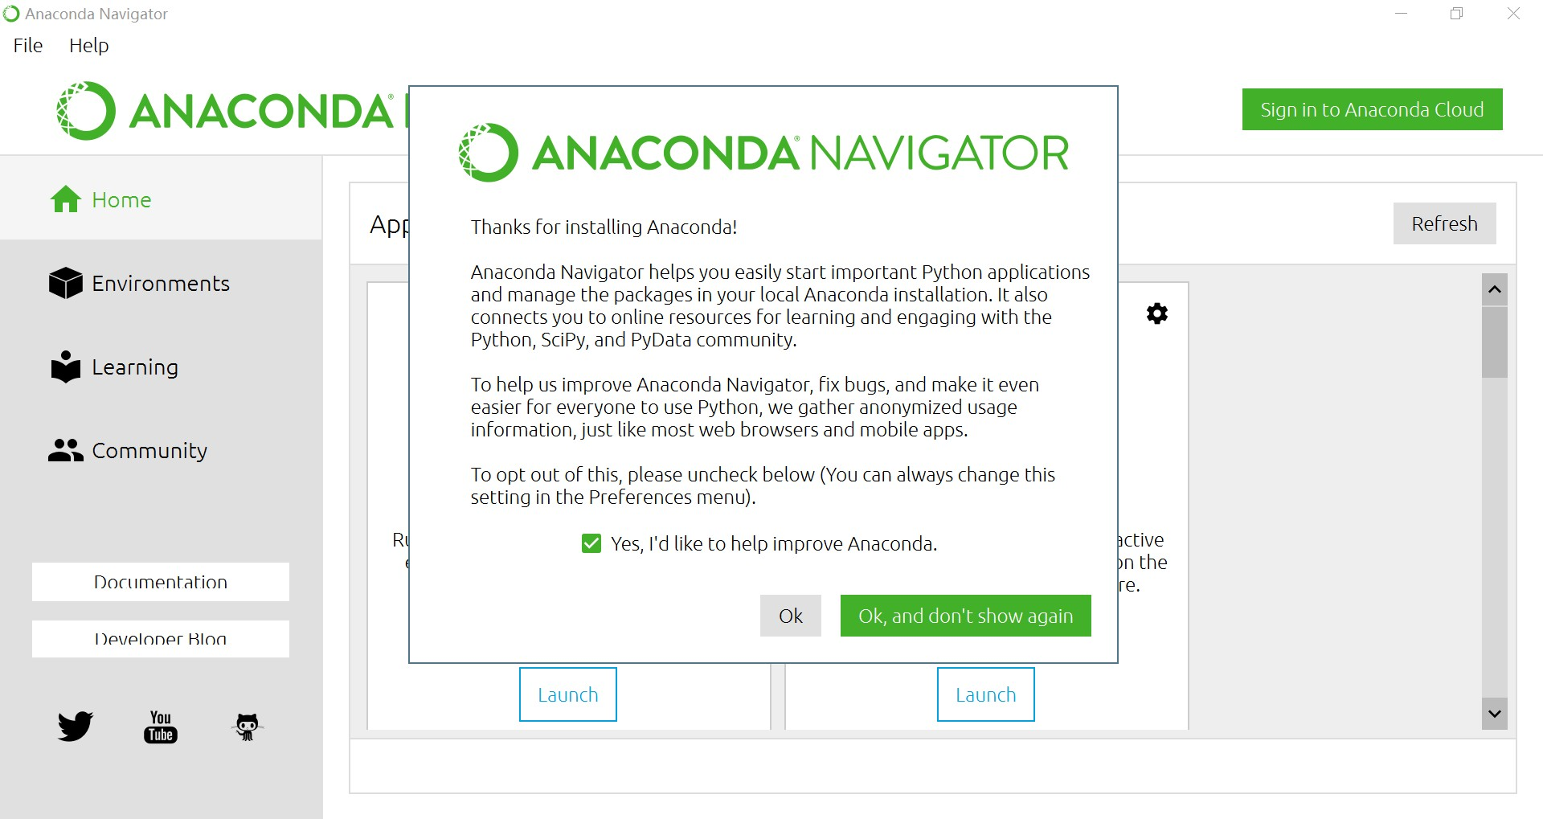
Check the success of installment
Right click
Run as an administrator Enter ”conda list”
1
Click and wait…
2

Slide 23

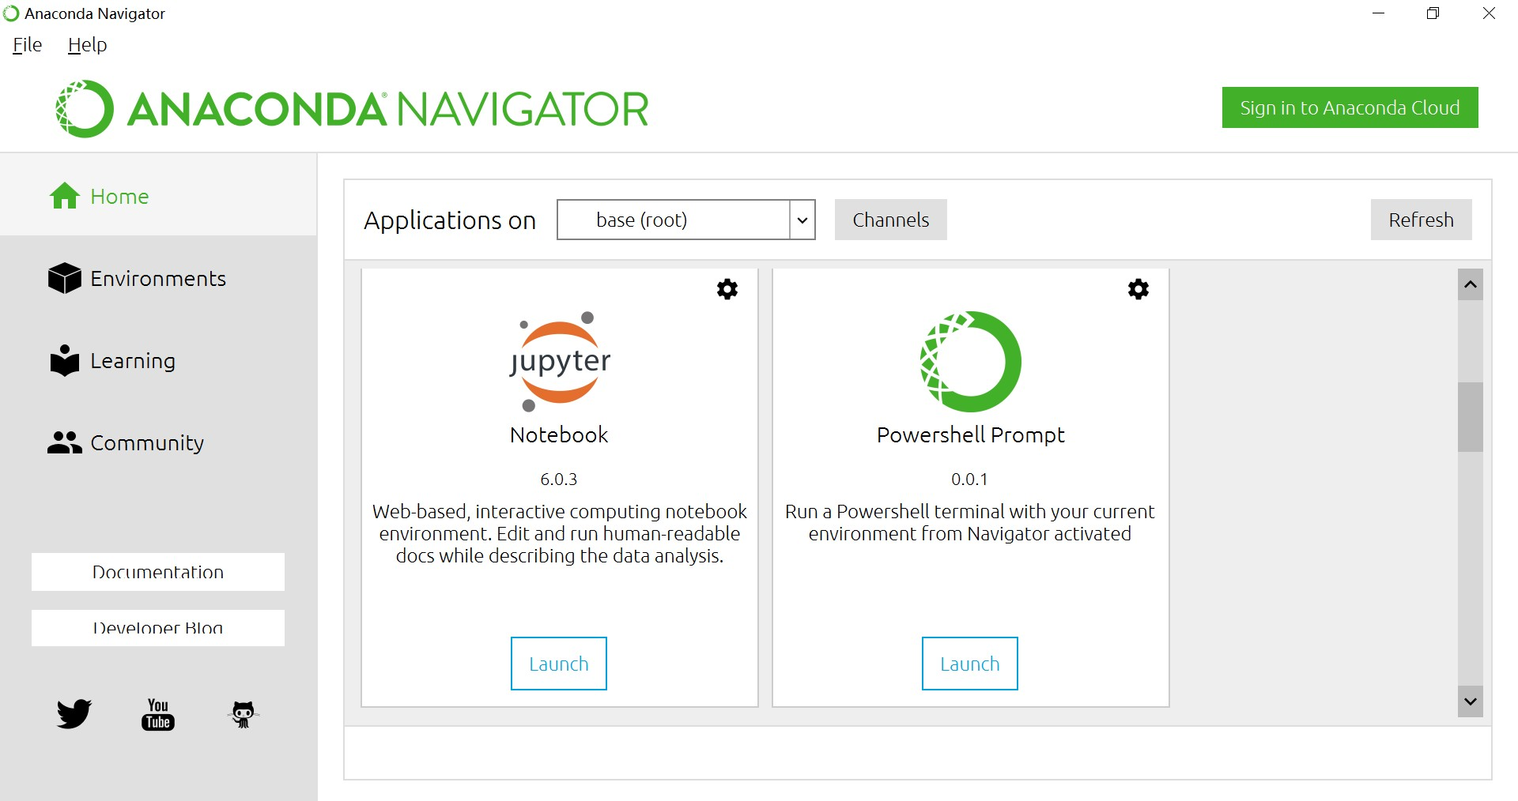
Enjoy!

Slide 24
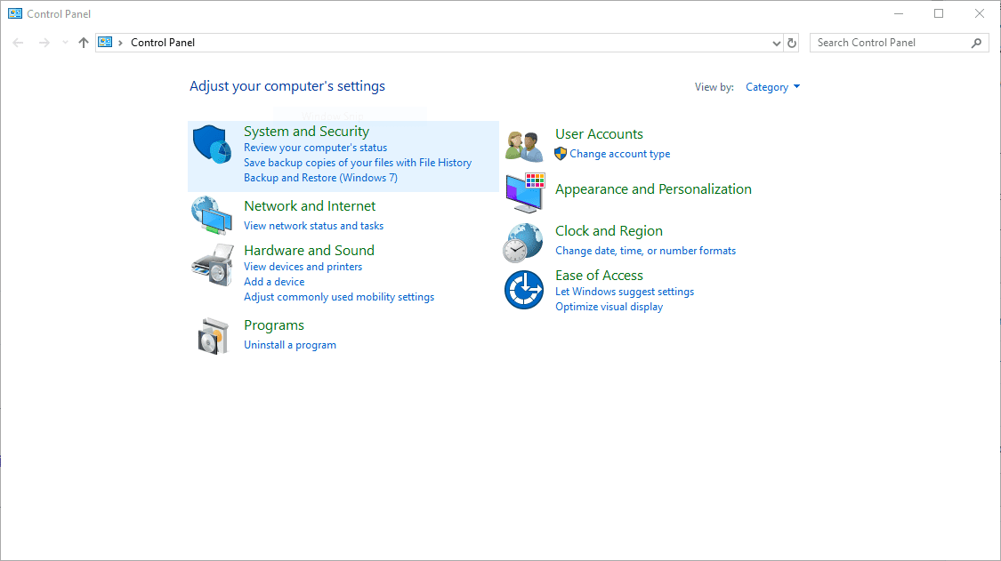
Changing Default Browser(Win), Optional
Opening Jupyter notebook in
your web browser of choice
https://support.microsoft.com/en-us/windows/change-your-default-browser-in-windows-10-020c58c6-7d77-797a-b74e-8f07946c5db6#:~:text=Select%20the%20Start%20button%2C%20and,Microsoft%20Edge%20or%20another%20browser.
https://support.google.com/chrome/answer/95417?co=GENIE.Platform%3DDesktop&hl=en
8

Slide 25

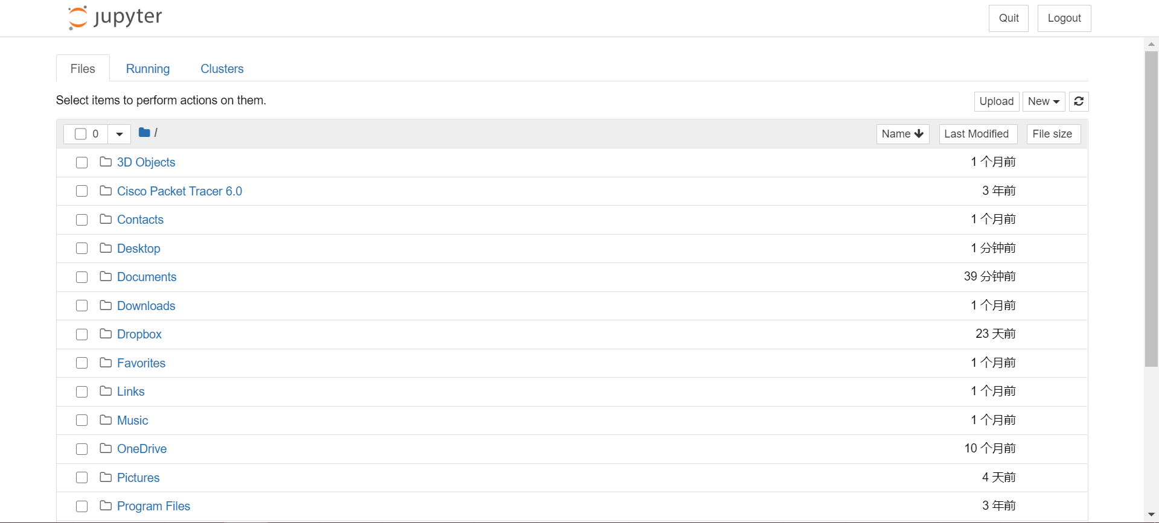
Or just click

